Slide 1


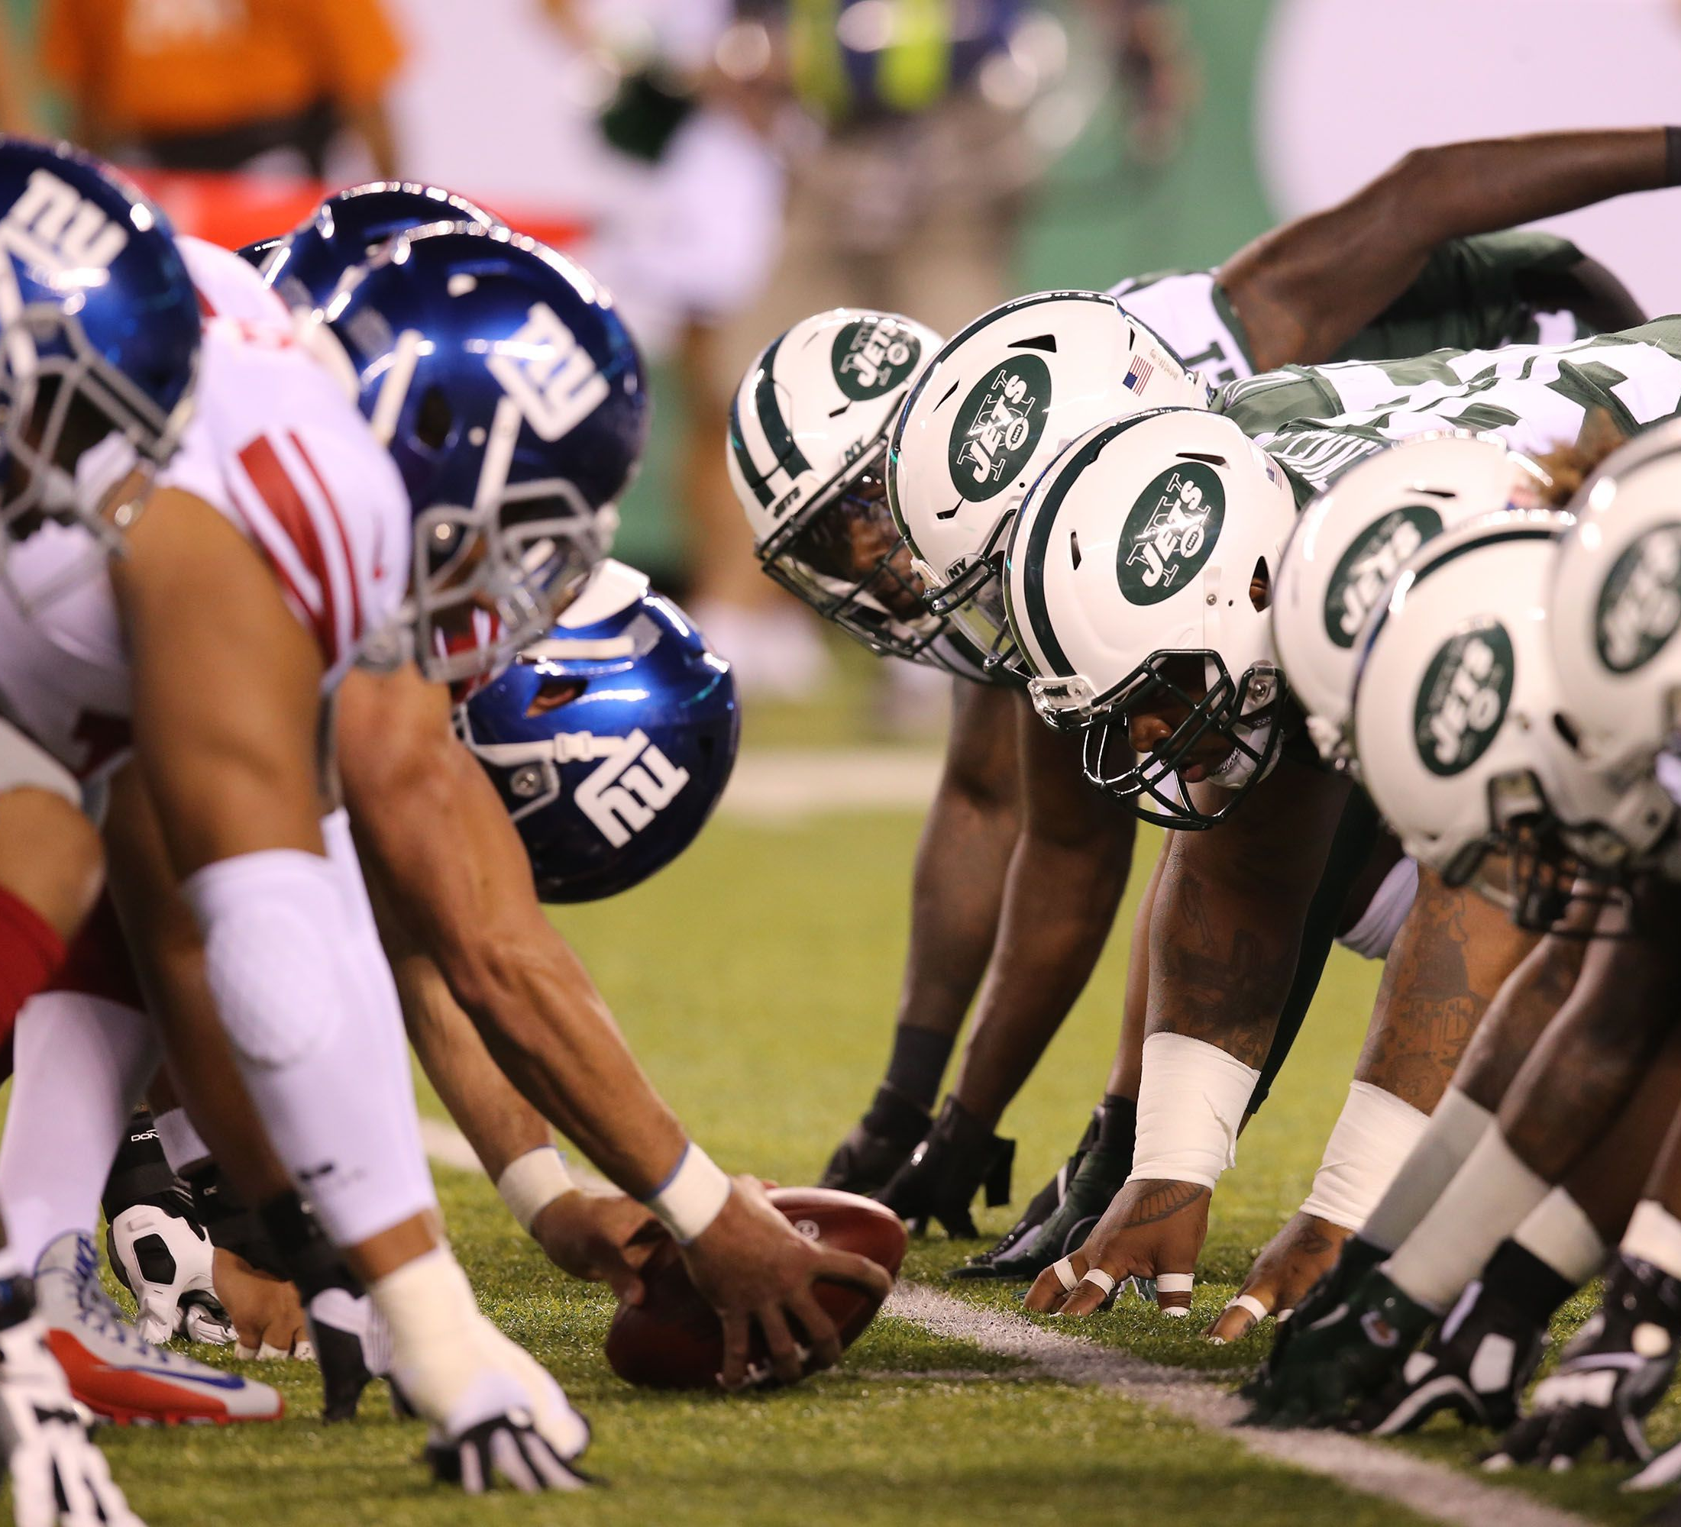
Analysis and Predictive Modeling for Play-calling in the NFL
Michael Flores
Flatiron School

Slide 2
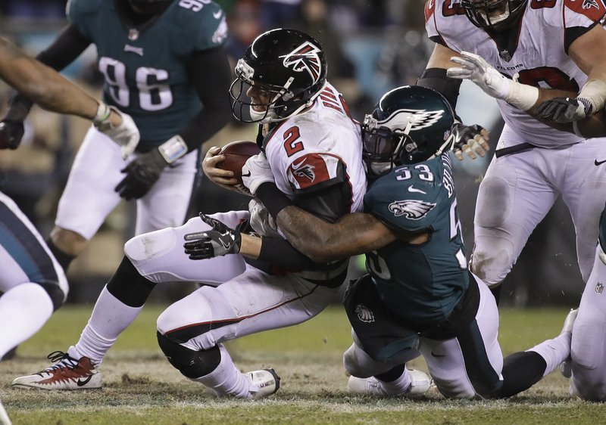
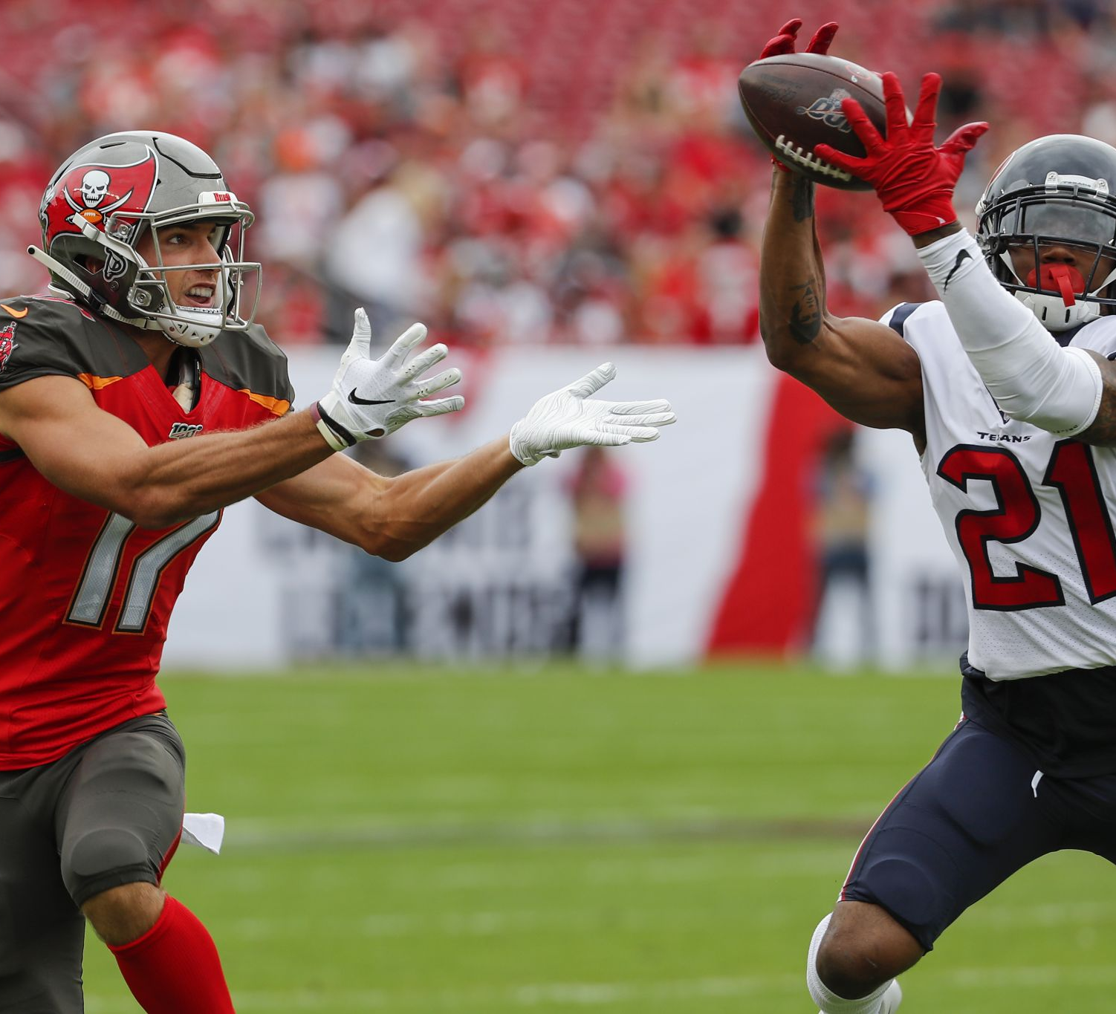
Introduction
“Defense wins championships” - Paul “Bear” Bryant
NFL offenses will play to their strengths and have certain plays they favor.
If a defense can pinpoint a play-call given the game situation, they can anticipate it ahead of time.
I wanted to design a predictive model that could predict whether a team would run or pass on a play.

Slide 3
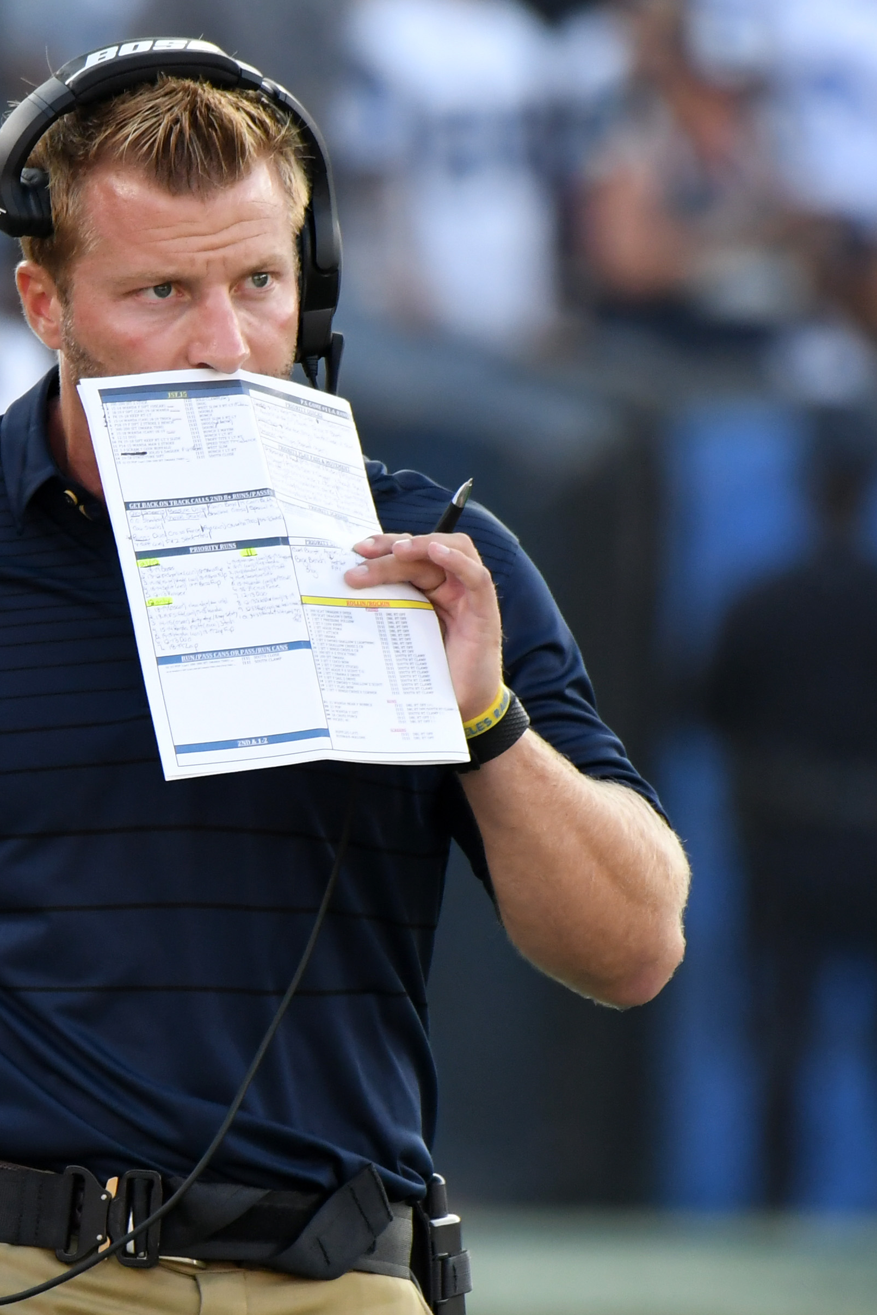
Data Information
The data consisted of nearly 350,000 plays that occurred between the 2009 and 2019 seasons.
Each play contained details about the play’s description/outcome as well as game details.
Each of the models were trained on details that an NFL defense would have in-game.

Slide 4
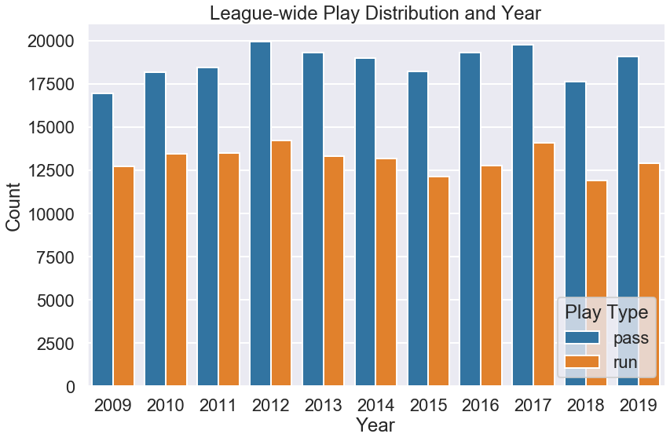
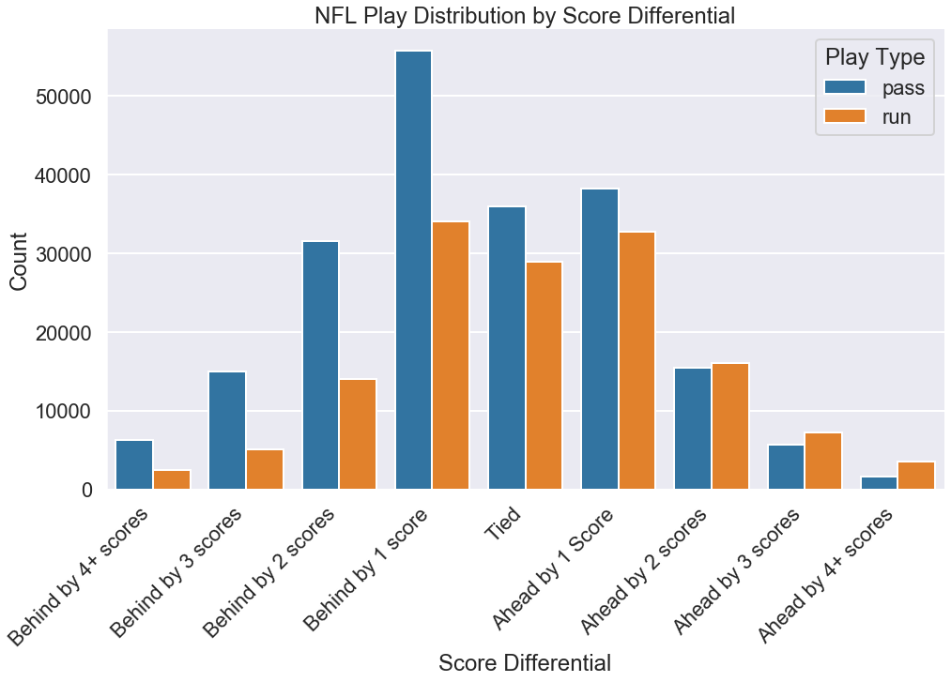
NFL General Trends
I first wanted to observe general trends across all the teams in the NFL.
Passing being quickly more favored when down by 1+ scores.

Slide 5
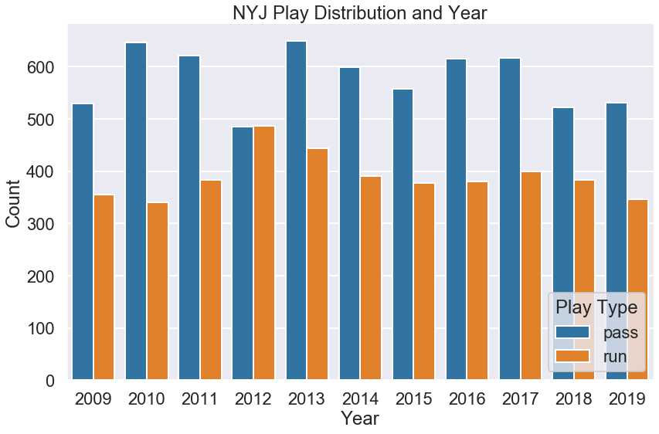
NFL Team Dashboard
I wanted to create visualizations that would help to identify trends and tendencies for each NFL team.
Visualizations for not only the entire span of the dataset, but each individual season as well.

Slide 6
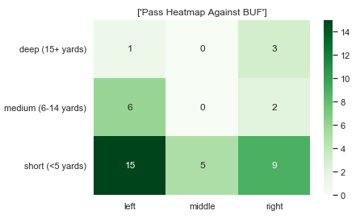
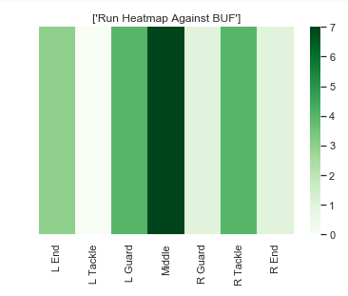
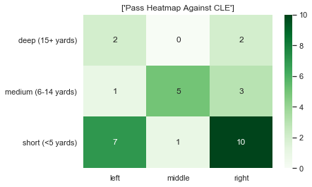
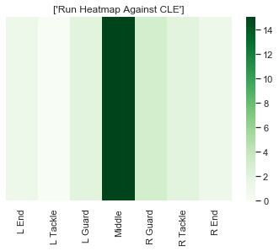
NFL Team Dashboard (cont.)
Visualize each team’s play-calling for both runs and passes for all their games.
Heatmaps showing which sides of the field a team’s offense favored for both runs and passes.
Helps to highlight what offenses liked to run against certain opponents.

Slide 7
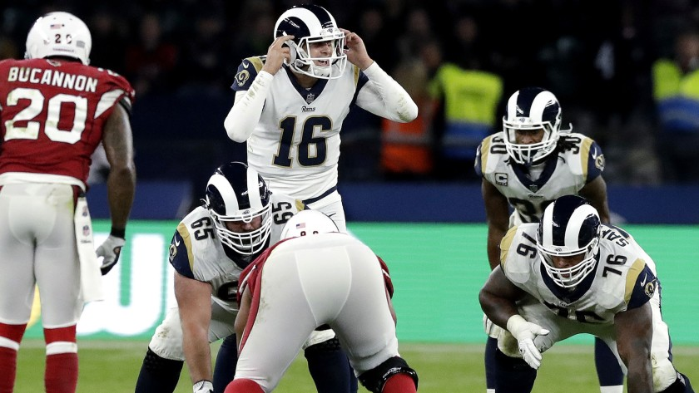
Predictive Modeling Results
Multiple machine learning models were tested such as Logistic Regression and Random Forests.
XGBoost performed the best out of all models tested.
Limitations include not having full details of each play and accounting for audibles.
Model Type: | Overall Accuracy: | Pass Recall: | Run Recall:
Logistic Regression | 0.720146 | 0.76 | 0.66
Decision Tree | 0.65432 | 0.71 | 0.58
Random Forest | 0.71647 | 0.73 | 0.7
Gridsearch | 0.74138 | 0.75 | 0.73
XGBoost | 0.75049 | 0.8 | 0.68

Slide 8
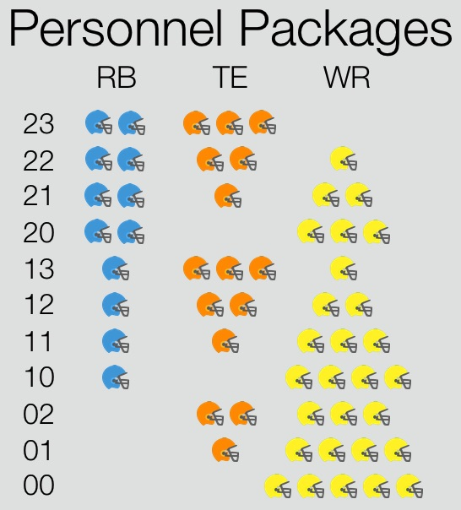
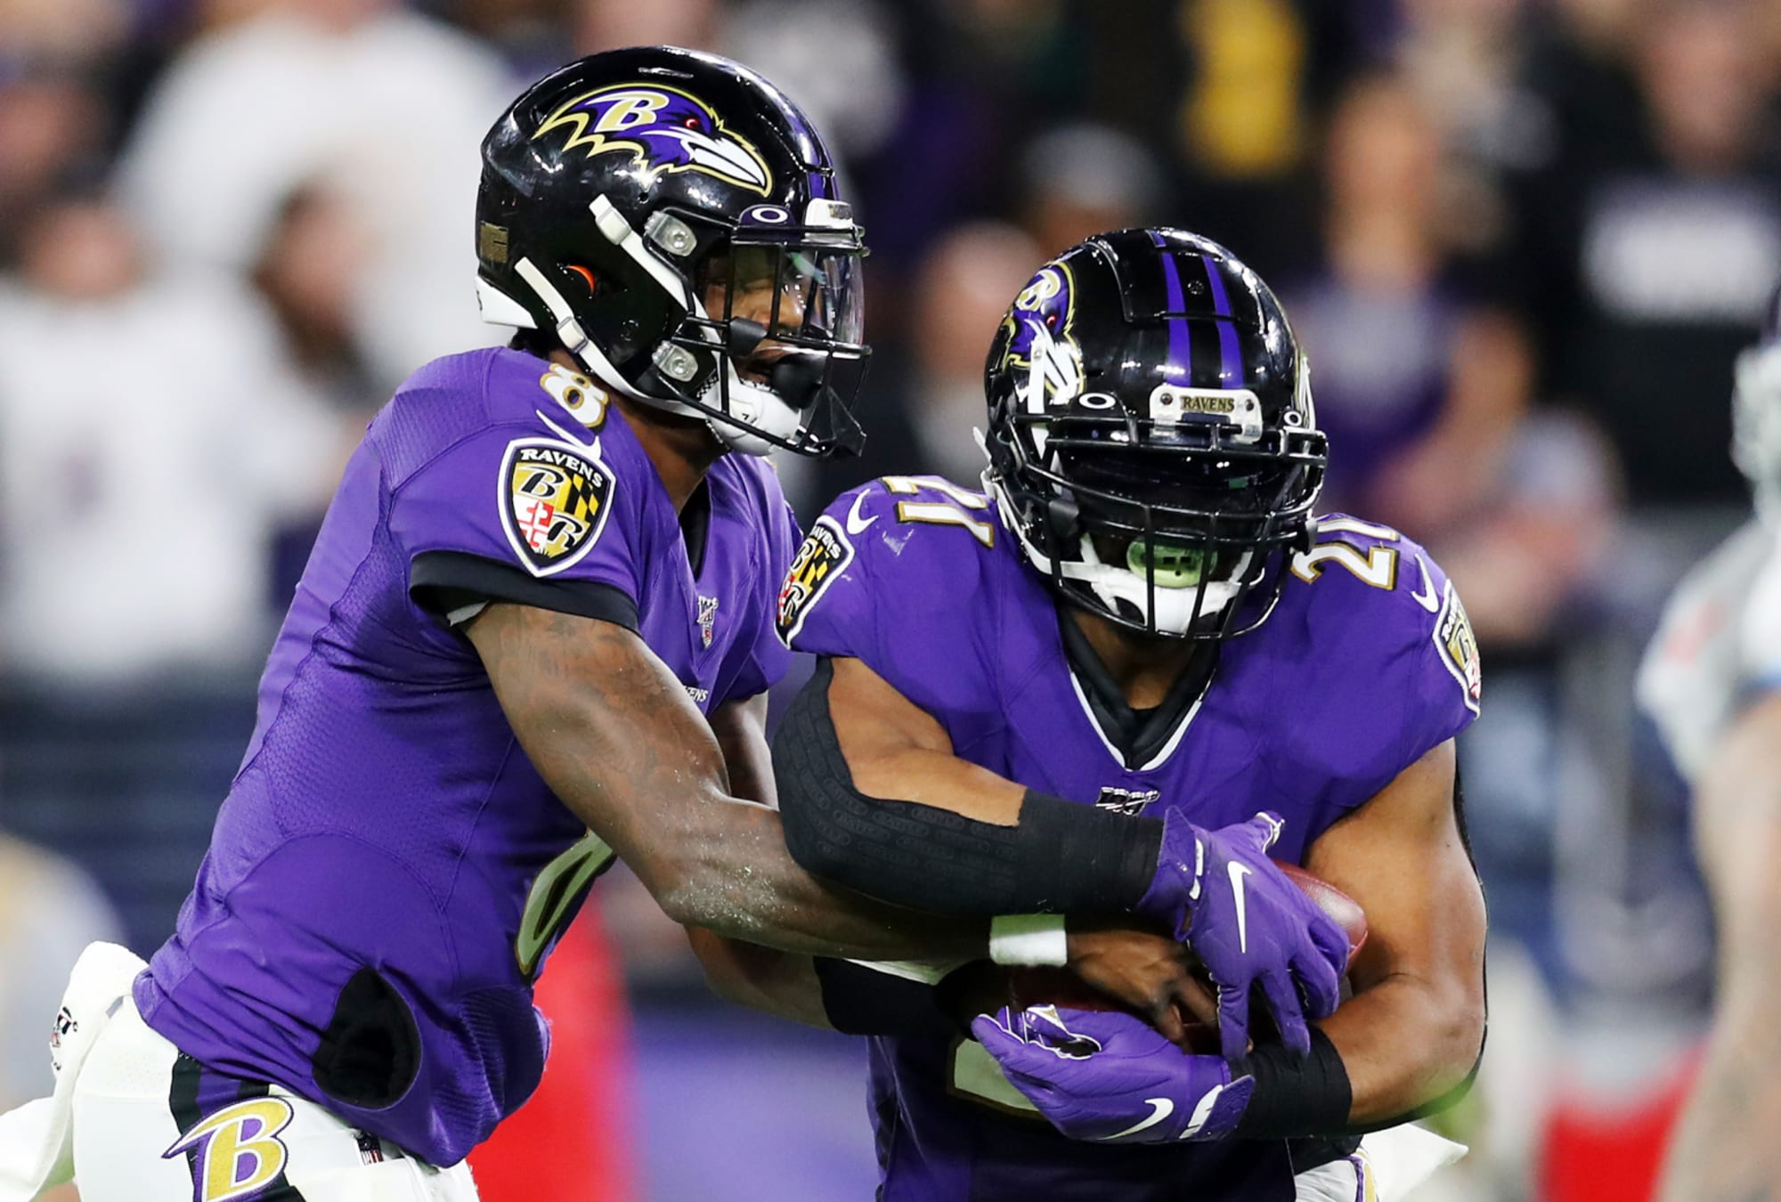
Future Work
Exploring how different personnel sets would influence the model’s accuracy.
Testing model performance across individual teams as opposed to the entire league.
Incorporating playoff situations and seeding into the model.
Deployment of an accessible web dashboard of each team’s play-calls and tendencies.

Slide 9
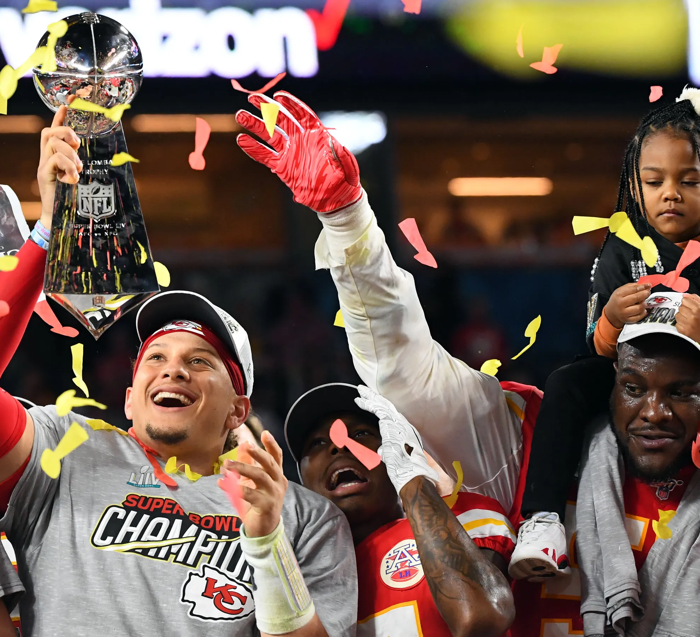
Thank you!
Michael Flores
Flatiron School

